Slide 1

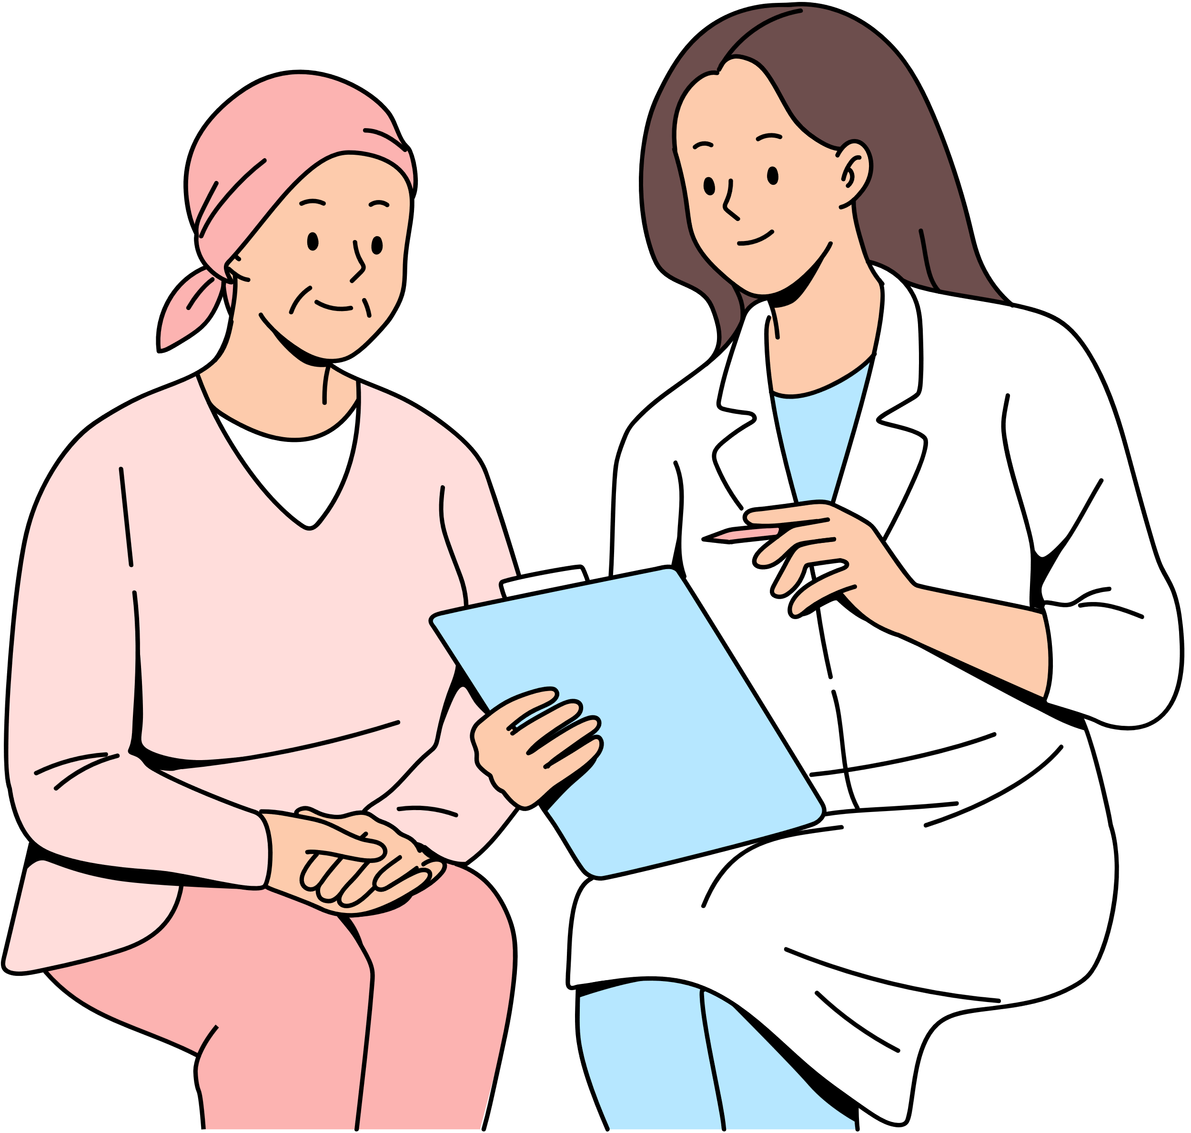
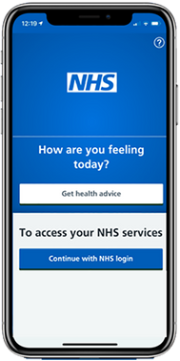
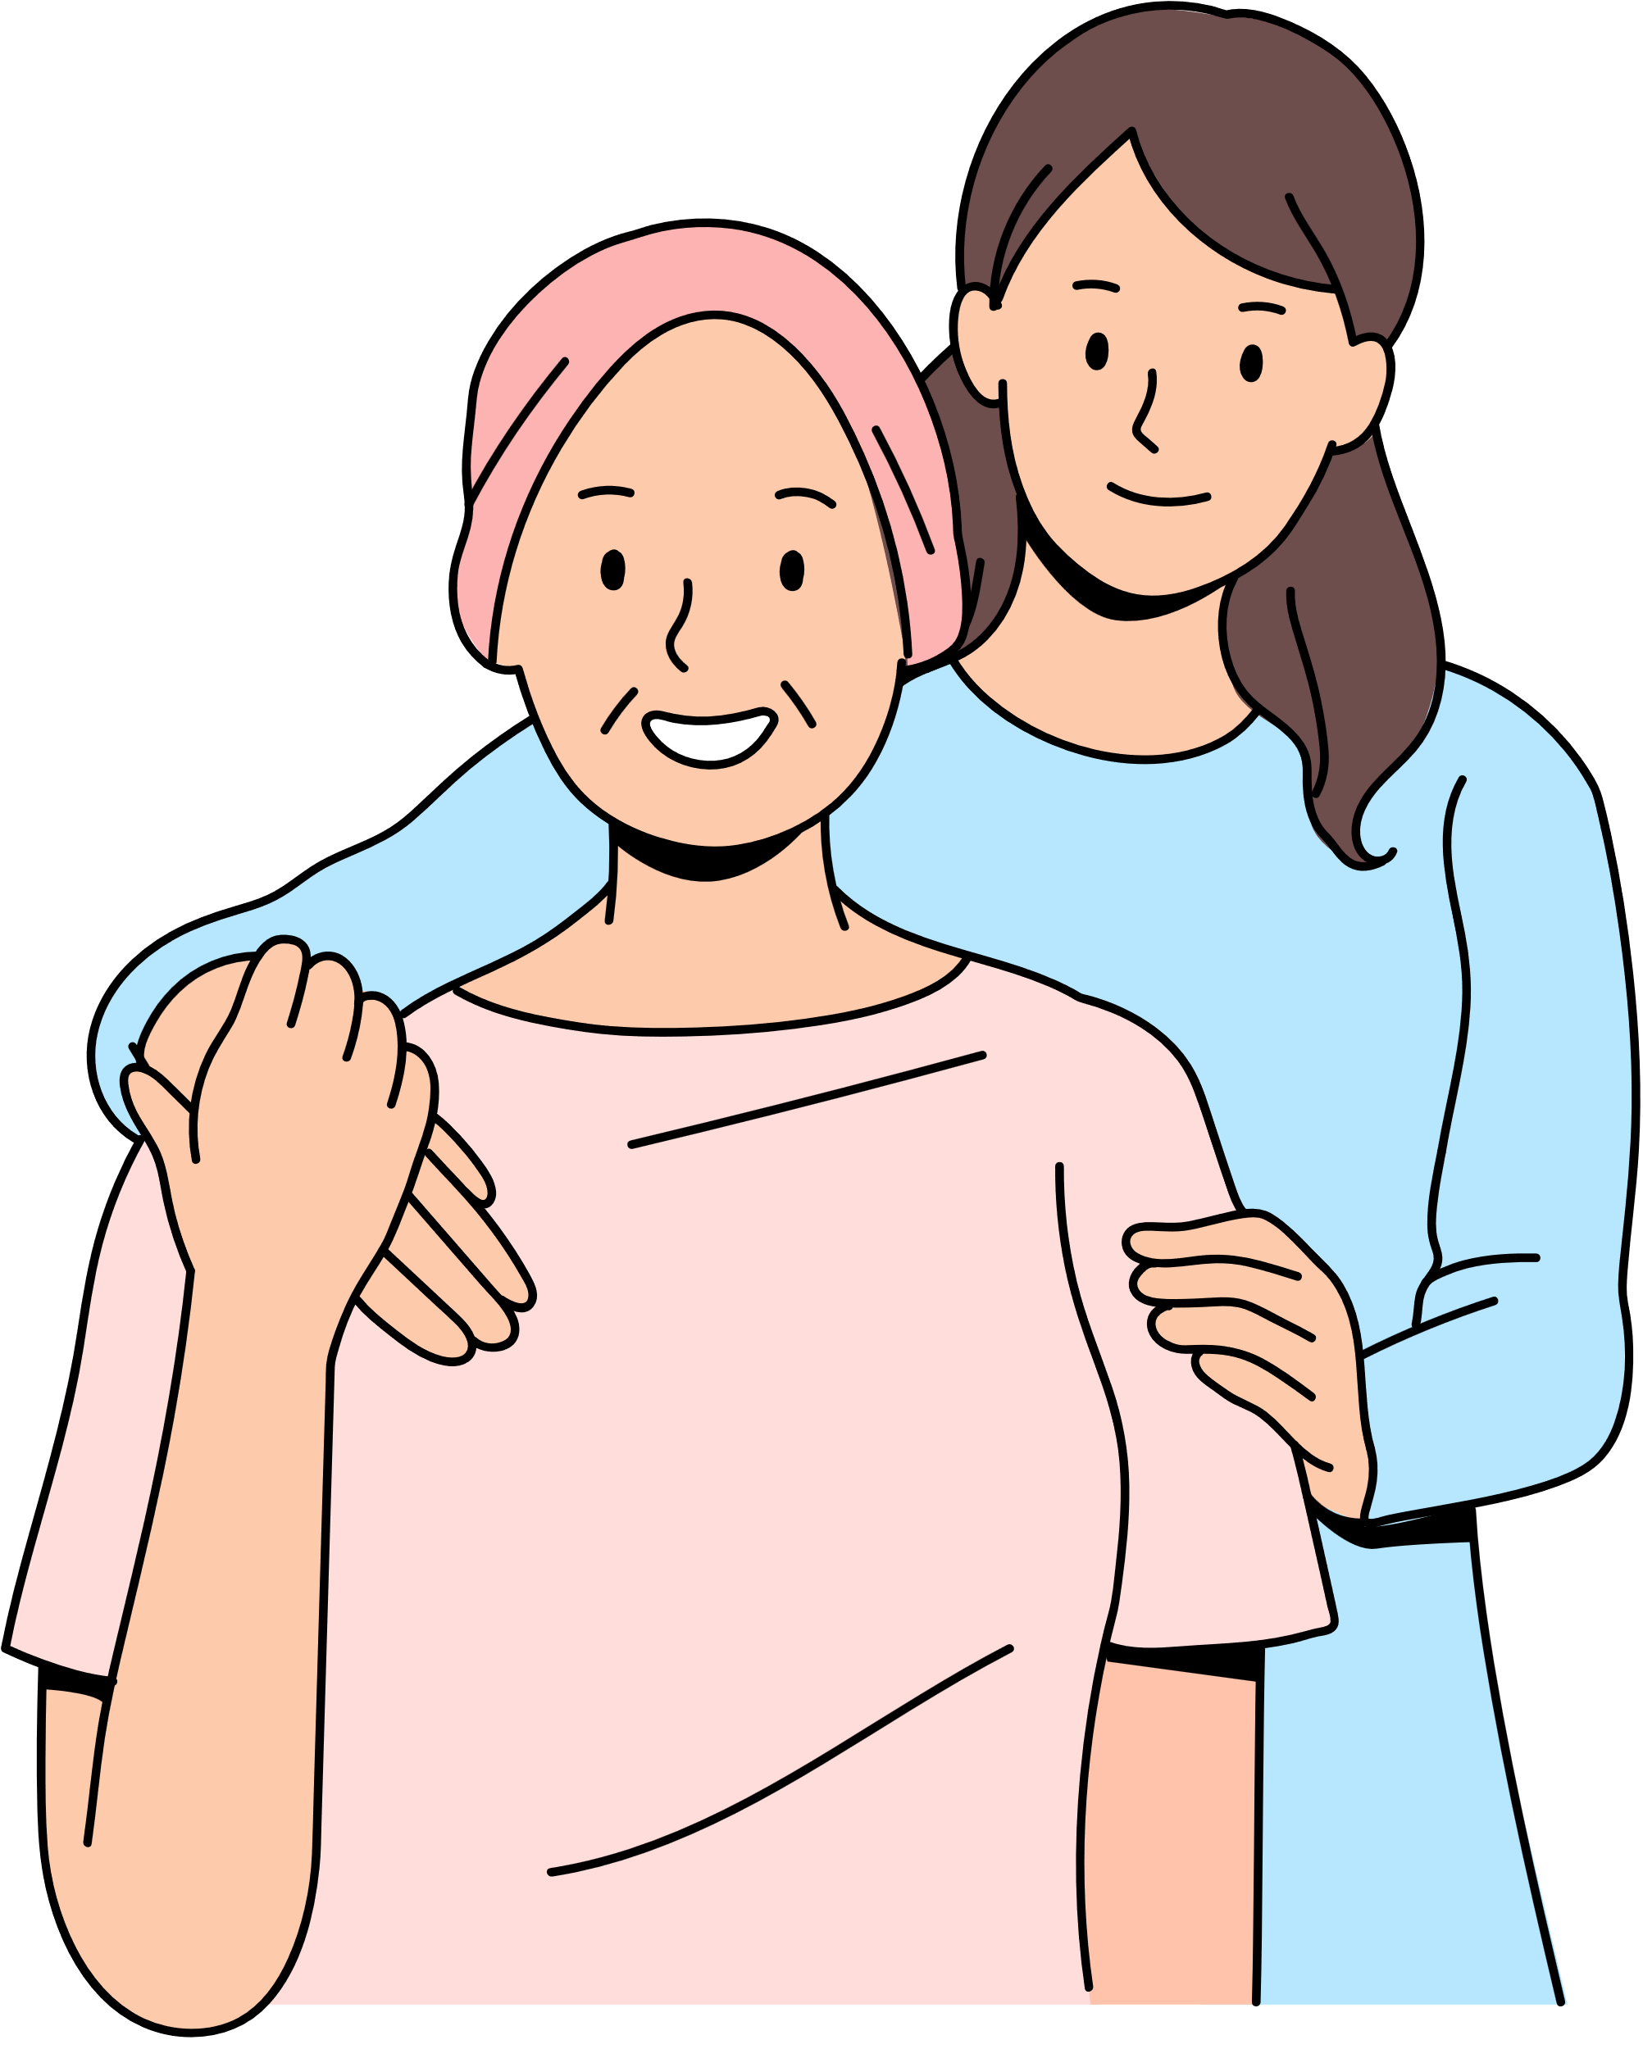


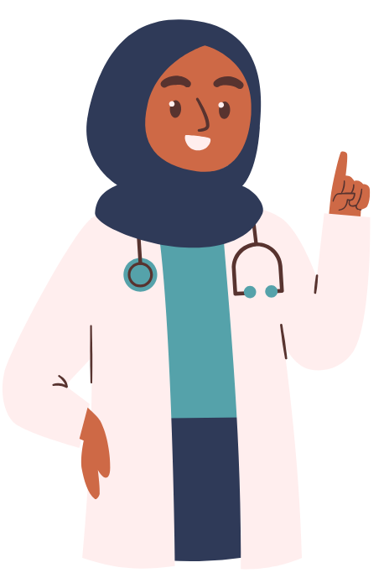

Improving Your Access To GP Services
We are working with local gp practices to make it easier for you to access the care you need,
When you need it - and from the right professional. This may not always be a gp, but the right person for your needs.
What We've Done So Far
What We're Doing in 2025/26
We have introduced a number of changes over the past few years to help with access including:
  Employed different clinicians as part of the practice team including Clinical Pharmacists, Social Prescribers and First Contact Physiotherapist for example
  Provided more appointments
  Cloud-based telephone system for better call handling
  Online consultations, giving you another way to contact us
Easier Contact by Phone
    Call-back option available, no need to wait on hold
    We aim to answer calls within 10 minutes
We are working together across practices and primary care organisations to provide additional appointments.
We will also be focusing on the areas highlighted in the boxes below:
Name the organization that supports your research.
What We're Doing in 2025/26
What We're Doing in 2025/26
Online Consultation
Care Navigation
  Available Monday to Friday, 8am-6.30pm (excluding bank holidays)
  Clinical queries: response by end of next working day
  Non-clinical queries: response within 3 working days
  Our team will guide you to the right support - whether by phone, in person, or online
  This may include booking an appointment with a GP, a member of our practice team, or signposting to services such as Community Pharmacy
Care Navigation
Improving Your Access to GP Services
Continuity of Care for Complex Needs
Sign Up for the NHS App
The NHS App helps you to:
  Help you manage your appointments
  Order repeat prescriptions
  View parts of your GP health record
  Access trusted health information
  If you're aged 13 or over, speak to our reception
  team, join one of our digital support workshops or
  click on the link to get started : Sign up to the NHS APP
  We listened to your feedback: continuity matters
  Some of our patients with complex health needs will get a named care team - These patients will be informed of their team
  Reviewing our appointments to ensure patients are seeing the right clinician at the right time
We Want to Hear From You!
In 2024, we:
  Ran a patient survey to gain your thoughts on access to GP services
  Held local face-to-face engagement events and a borough wide webinar
We're committed to improving with your help. We'll continue to involve you through:
  Patient Participation Group (PPG) meetings
  Feedback via our practice website
  Local health engagement events
For 2025/26, we will:
Develop a new patient survey with your help through the Patient Participation Group (PPG)
Share the survey widely
Host another open engagement session – all welcome!
Thank you for helping us shape better GP services for our community.

